Slide 1

DATA MANIPULATION - PART 2
October 3, 2020
11:00 am - 1:00 pm

Slide 2
Time | Activity | Speaker/ Moderator
11:00 am – 11:05 am | Participants joining
11:05 am – 11:10 am | Welcoming remarks and introducing the speaker | Lucy Njuki
11:10 am – 11:25 am | Session 1: Introduction to string manipulation | Christine Okeyo
11:25 am – 11:40 am | Session 2: Introduction to date manipulation | Christine Okeyo
11:40 am – 12:00 pm | Session 3: Merging and appending data | Christine Okeyo
12:00 am – 12:20 pm | Session 4: Reshaping data | Christine Okeyo
12:20 pm – 12: 40 pm | Practical exercise | Christine Okeyo, Lucy Njuki, Faith Musili , Shelmith Kariuki & Kelvinson
12:40 pm – 12:50 pm | Questions and feedback | Christine Okeyo & Lucy Njuki
12:50 pm – 13:00 pm | Closing remarks | Lucy Njuki

Slide 3
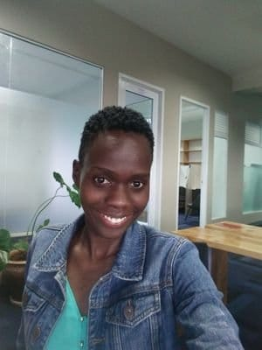
Our trainer
Christine Okeyo
Data Analyst, Greenlight Planet

Slide 4
Questions and feedback

Slide 5


Slide 6
THANK YOU
Email address: nairobi@rladies.org
LinkedIn: R-Ladies Nairobi
Twitter: @RLadiesNairobi
Meetup: https://www.meetup.com/rladies-nairobi/

